Slide 1
Institutionalized Inequities: Property Taxation in Chicago and Beyond
Christopher Berry
William J. and Alicia Townsend Friedman Professor of Political Economy
Faculty Director, Center for Municipal Finance, The University of Chicago
Eric Langowski
Data Science Affiliate, Center for Municipal Finance, University of Chicago

Slide 2
How Property Taxes are Calculated
Basic Property Tax Cycle
1a. Overall amount of money needed to run government determined (Levy)
1b. Value of property determined
2. Tax rate determined (Levy/Overall Value)
3. Rate applied to individual properties (including exemptions, etc.)
IF YOUR PROPERTY IS OVER-ASSESSED (GIVEN TOO HIGH A VALUE), YOU PAY MORE THAN YOUR FAIR SHARE OF TAXES
Property
Assessment
Revenue
Collection -
Per Home
Rate
Calculation
Levy
Determination

Slide 3
Levy = $1,500
Actual value = $100,000
Accurate tax = $500 (1/3 of levy)
Actual value = $200,000
Accurate tax = $1,000 (2/3 of levy)
Regressive assessed value = $125,000
Regressive tax = $682 (45% of levy)
Tax shift = + $182
Regressive assessed value = 150,000
Regressive tax = $818 (55% of levy)
Tax shift = -$182

Slide 4
Levy = $1,500
Actual value = $100,000
Accurate tax = $500 (1/3 of levy)
Actual value = $200,000
Accurate tax = $1,000 (2/3 of levy)
Regressive assessed value = $90,000
Regressive tax = $562 (37.5% of levy)
Tax shift = + $62
Regressive assessed value = 150,000
Regressive tax = $938 (62.5% of levy)
Tax shift = -$62
Notes:
This slide illustrates that even when the low value home is under-assessed relative to true value, it will be over taxed if high value home is under assessed more

Slide 5
What Does a Fair and Accurate System Look Like?
The sales ratio is the assessor’s estimate of a property’s value divided the property’s sale price. If assessments are accurate, the sales ratio is equal to 1 for all homes.
2
Orange line = Fair and accurate assessments, all homes assessed at market value. Sales ratio = 1 for all homes
If the sales ratio is greater than 1, a home is over-assessed. If the sales ratio is less than 1, a home is under-assessed. A system in which less expensive homes are assessed at higher ratios than more expensive homes is regressive.
1
Sales Ratio
When assessments are regressive, owners of more expensive homes pay less in property taxes than they should while owners of less expensive homes pay too much.
0
Low
Home Value
High

Slide 6
What is regressivity and why is it unfair?
The sales ratio is the assessor’s estimate of a property’s value divided the property’s sale price. If assessments are accurate, the sales ratio is equal to 1 for all homes.
Blue line = Regressive assessments, less expensive homes assessed at higher rate than more expensive homes
2
Orange line = Fair and accurate assessments, all homes assessed at market value. Sales ratio = 1 for all homes
If the sales ratio is greater than 1, a home is over-assessed. If the sales ratio is less than 1, a home is under-assessed. A system in which less expensive homes are assessed at higher ratios than more expensive homes is regressive.
1
Sales Ratio
When assessments are regressive, owners of more expensive homes pay less in property taxes than they should while owners of less expensive homes pay too much.
0
Low
Home Value
High

Slide 7
Sources of Regressivity in Property Taxes
Assessor problems
Omitted variables: Factors observable to buyers and sellers but unobservable to the assessor (often not the fault of the assessor)
Poor modeling of observable variables; e.g., location and time
Policy choices
Assessment increase caps
Exemptions/abatements
Appeals

Slide 8
“Reassessing the Property Tax” (Berry 2021)
Vertical inequity is not just a problem for a few jurisdictions; it is the norm
Nationwide study of vertical equity
Based on data from Corelogic
Finding vertical inequity in 90% + jurisdictions
Evident according to many different metrics
Over and under assessment highly spatially clustered
Resulting in neighborhood-level over and under-assessment
Predominantly African American neighborhoods substantially over-assessed, on average
The does NOT imply that assessors are racially motivated
Correlation between race and home value

Slide 9
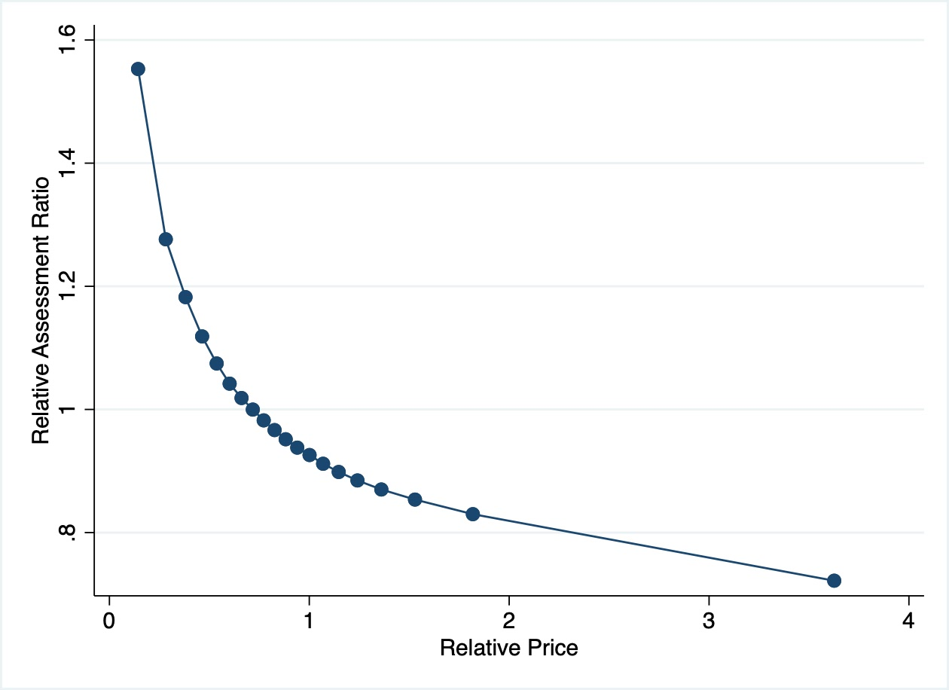
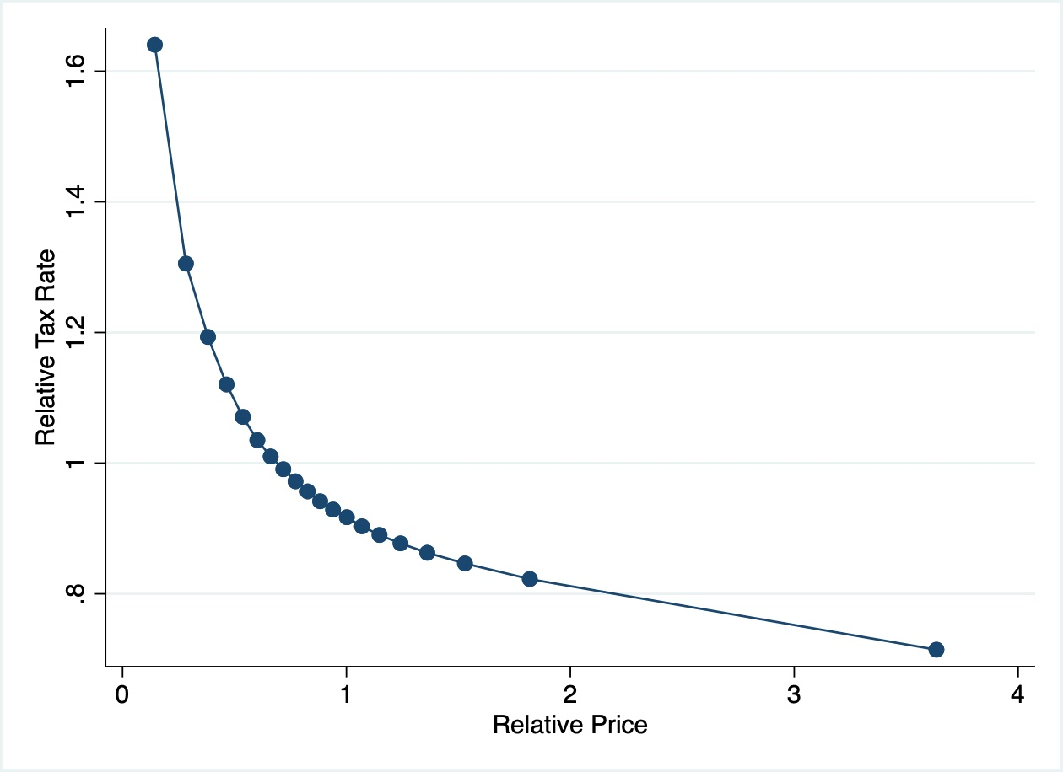
Nationwide Binned Scatter Plots for Assessments and Taxes
Nationwide Assessment Regressivity
Nationwide Property Tax Regressivity

Slide 10
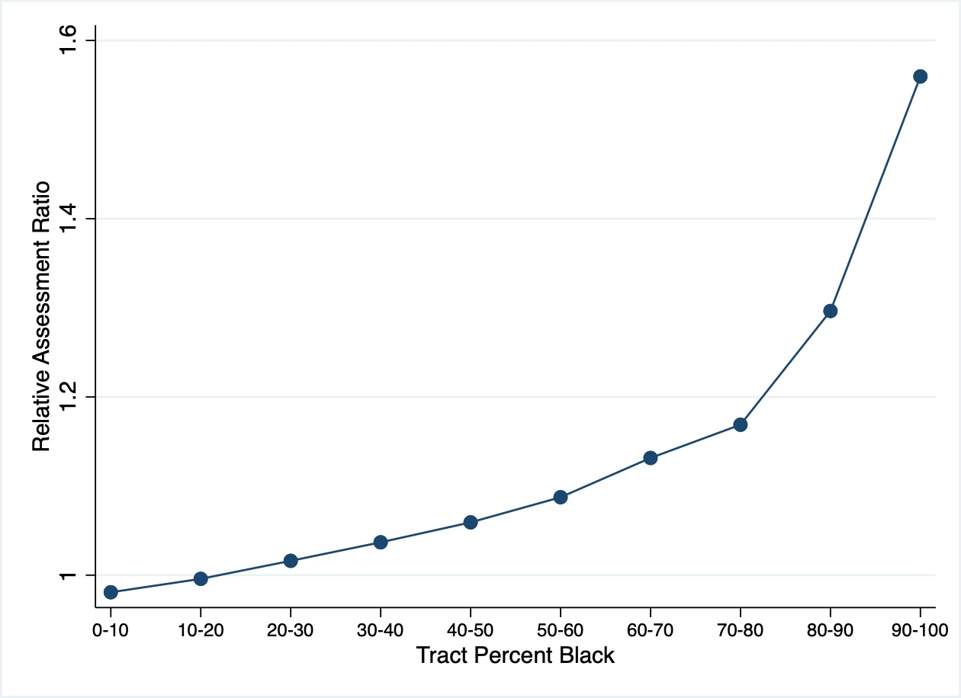
Census Tract Racial Composition

Slide 11
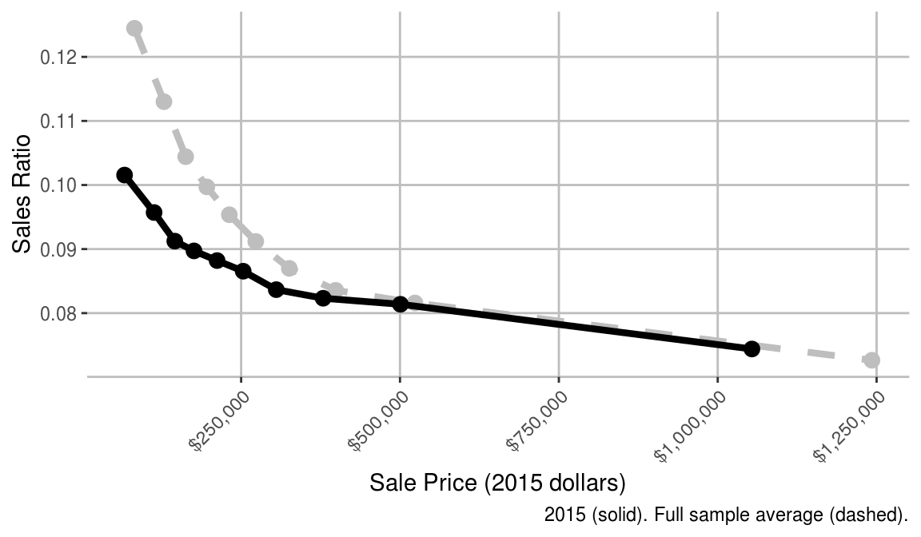
Regional Comparisons: Cook County
In 2015, the most expensive homes (the top decile) were assessed at 7.4% of their value and the least expensive homes (the bottom decile) were assessed at 10.2%. In other words, the least expensive homes were assessed at 1.36 times the rate applied to the most expensive homes. Across our sample from 2006 to 2015, the most expensive homes were assessed at 7.3% of their value and the least expensive homes were assessed at 12.4%, which is 1.71 times the rate applied to the most expensive homes.

Slide 12
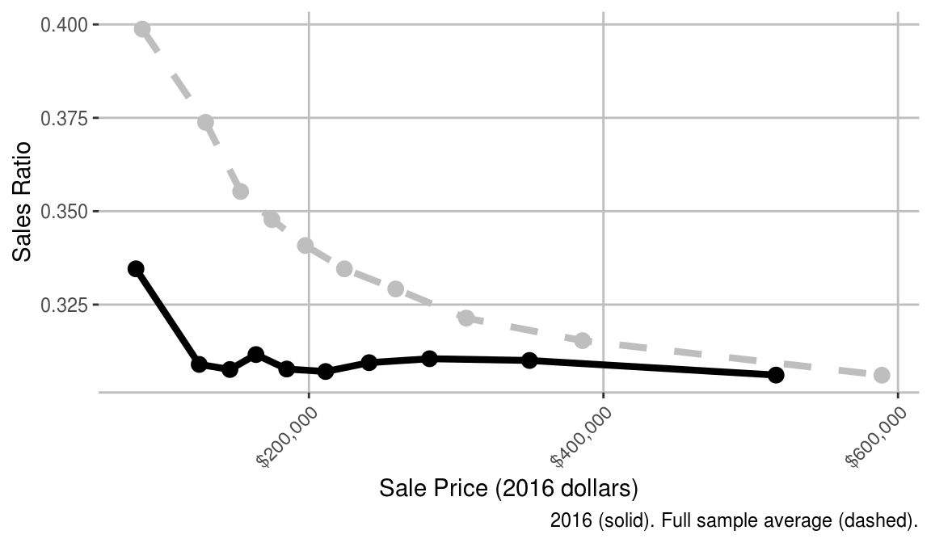
Regional Comparisons: Will County
In 2016, the most expensive homes (the top decile) were assessed at 30.6% of their value and the least expensive homes (the bottom decile) were assessed at 33.5%. In other words, the least expensive homes were assessed at 1.09 times the rate applied to the most expensive homes. Across our sample from 2007 to 2016, the most expensive homes were assessed at 30.6% of their value and the least expensive homes were assessed at 39.9%, which is 1.3 times the rate applied to the most expensive homes.

Slide 13
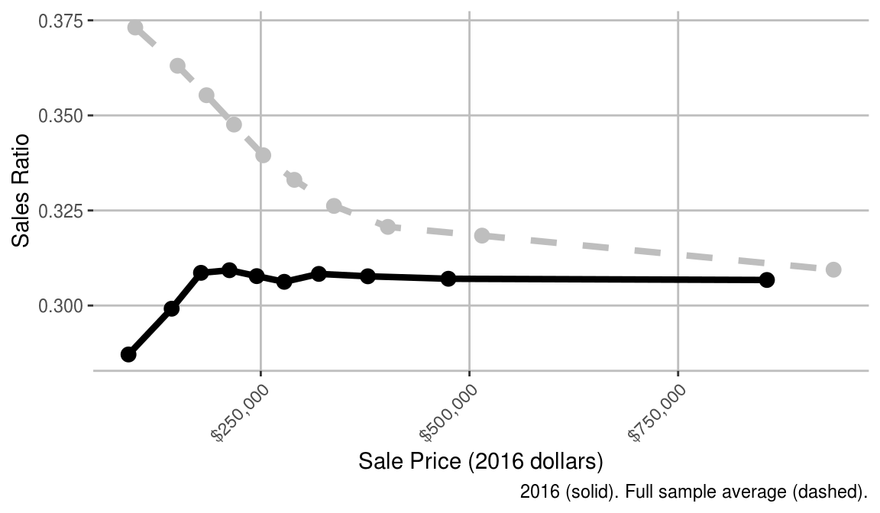
Regional Comparisons: DuPage County
In 2016, the most expensive homes (the top decile) were assessed at 30.7% of their value and the least expensive homes (the bottom decile) were assessed at 28.7%. In other words, the least expensive homes were assessed at 0.94 times the rate applied to the most expensive homes. Across our sample from 2007 to 2016, the most expensive homes were assessed at 30.9% of their value and the least expensive homes were assessed at 37.3%, which is 1.21 times the rate applied to the most expensive homes.

Slide 14
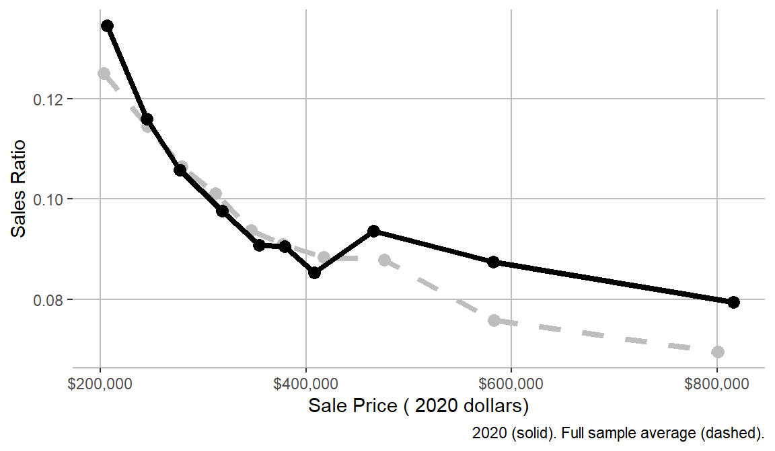
Regional Comparisons: La Grange Park
In 2020, the most expensive homes (the top decile) were assessed at 8.0% of their value and the least expensive homes (the bottom decile) were assessed at 13.4%. In other words, the least expensive homes were assessed at 1.69 times the rate applied to the most expensive homes. Across our sample from 2010 to 2020, the most expensive homes were assessed at 7.0% of their value and the least expensive homes were assessed at 12.5%, which is 1.79 times the rate applied to the most expensive homes.

Slide 15
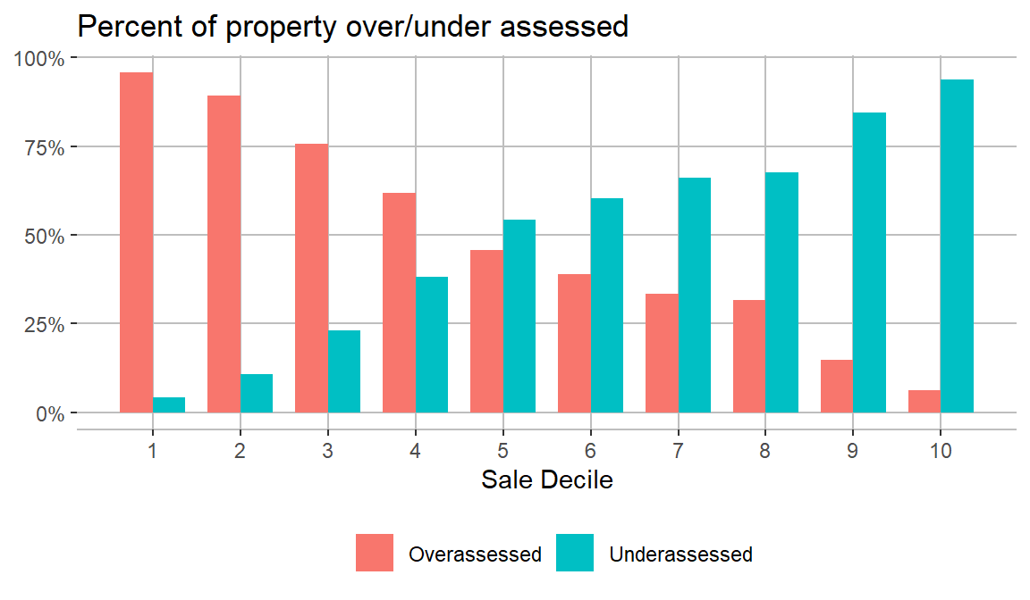
Regional Comparisons: La Grange Park
From 2010 to 2020, In La Grange Park, 96% of the lowest value homes are overassessed and 6% of the highest value homes are overassessed.

Slide 16
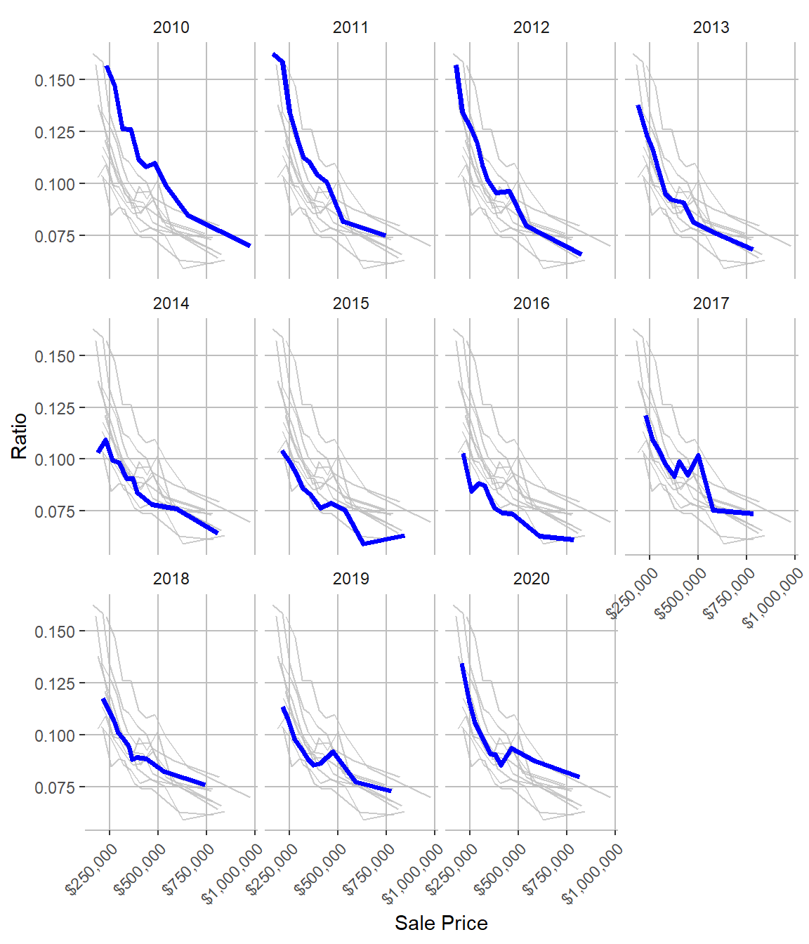
Regional Comparisons: La Grange Park

Slide 17
Cook County
The property tax system in Cook County is implemented across numerous government agencies including:
local government bodies such as the City of Chicago, school districts who set tax levies
the Assessor which sets assessments and handles appeals
the Board of Review which handles appeals
the Property Tax Appeal Board which handles appeals
the Treasurer which determines tax bills
Each one of these government entities has made numerous choices which lead to our current property tax system. Changing the system is beyond the ability of a single entity.
There are three key ‘steps’ of the property tax system: assessments, appeals, and tax bills.

Slide 18
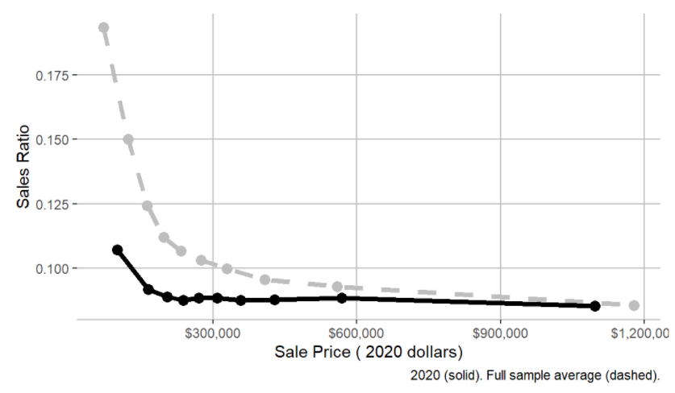
Assessments
In 2020, the most expensive homes (the top decile) were assessed at 8.5% of their value and the least expensive homes (the bottom decile) were assessed at 10.7%. In other words, the least expensive homes were assessed at 1.25 times the rate applied to the most expensive homes. Across our sample from 2010 to 2020, the most expensive homes were assessed at 8.6% of their value and the least expensive homes were assessed at 19.3%, which is 2.26 times the rate applied to the most expensive homes.

Slide 19
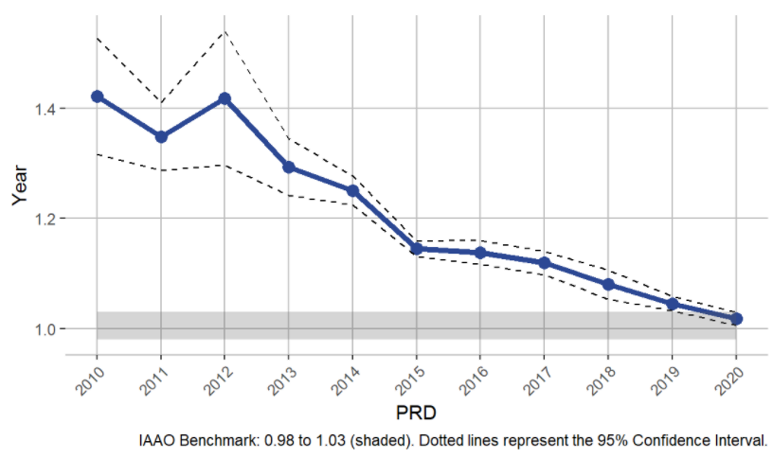
Assessments
The PRD is a measure of regressivity, or vertical equity. A PRD of 1 indicates that homes are assessed at the same rate regardless of their sale price. A PRD greater than 1 indicates that less expensive homes are assessed at higher rates than more expensive homes, while a PRD less than 1 represents the opposite situation. The IAAO specifies that the acceptable range of PRD is .98 to 1.03, which is depicted as the shaded region of Figure 3.2.

Slide 20
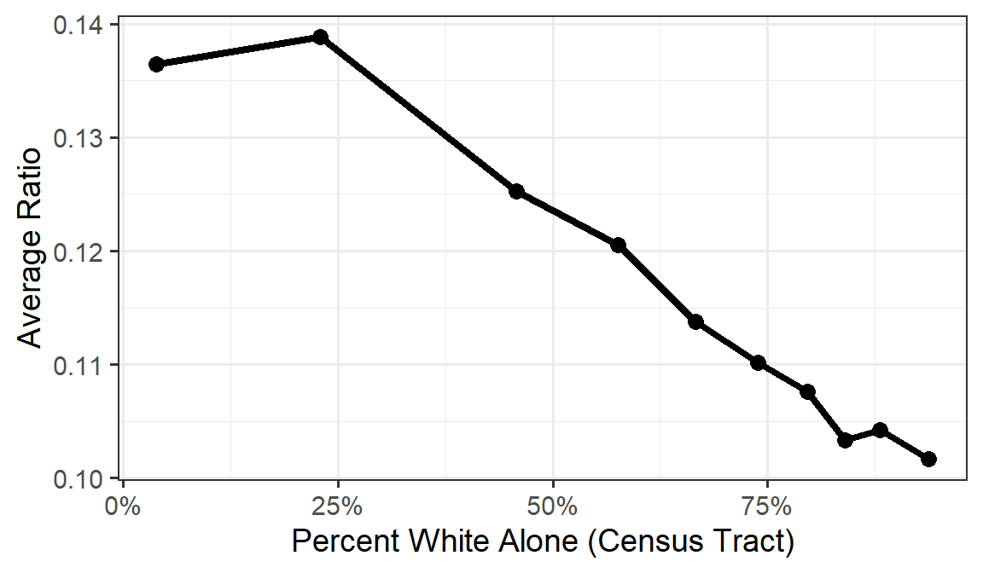
Sales Ratio & Race (2010 to 2020)

Slide 21
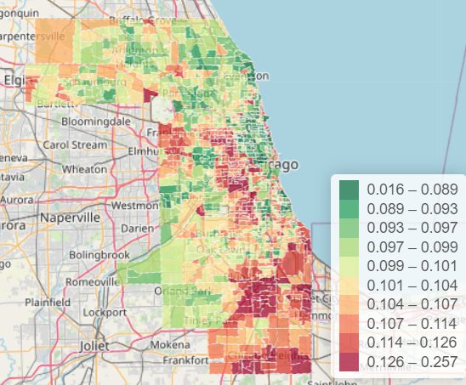
Average Ratio
A

Slide 22
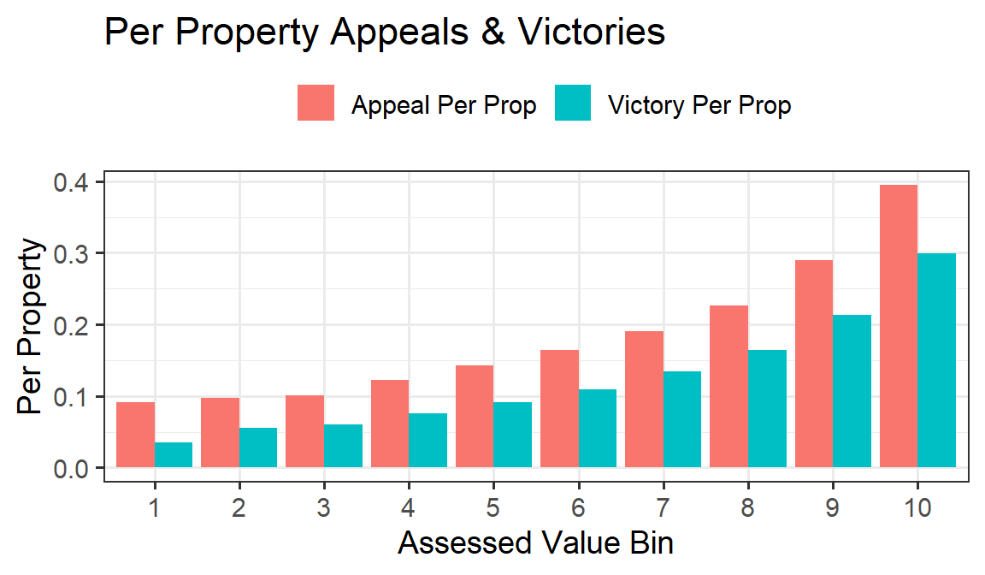

Slide 23
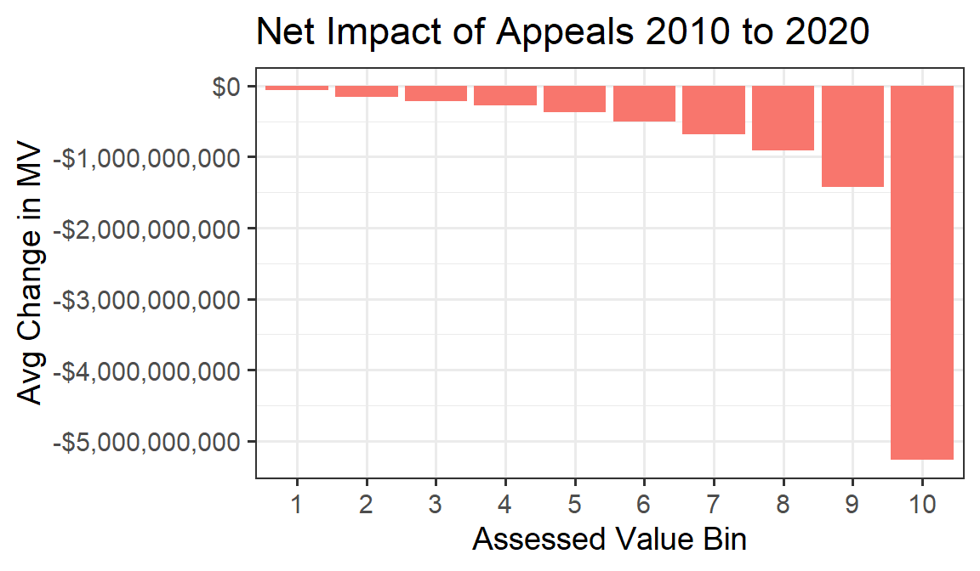

Slide 24
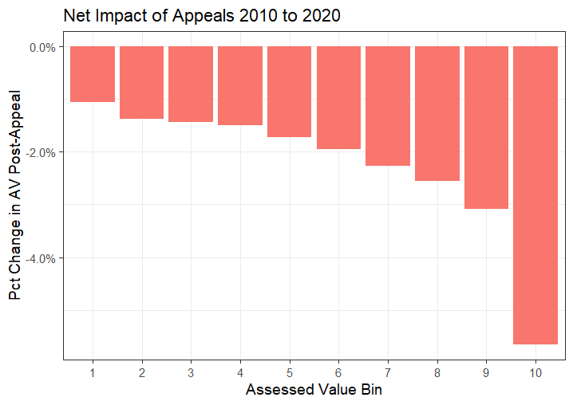

Slide 25
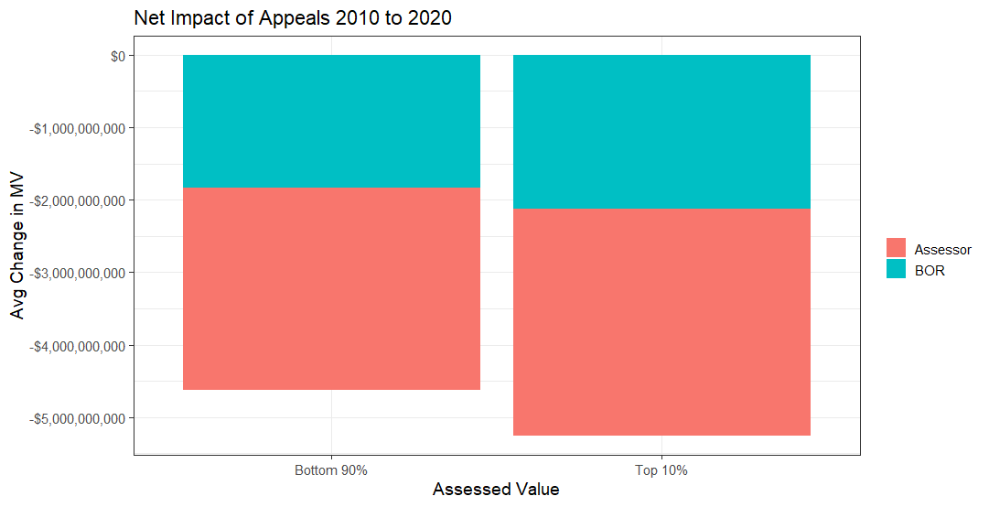

Slide 26
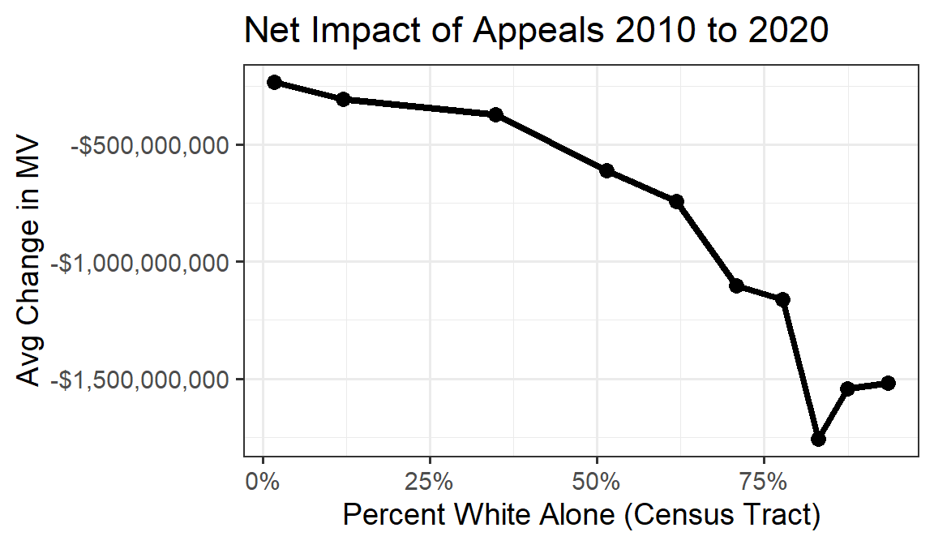

Slide 27
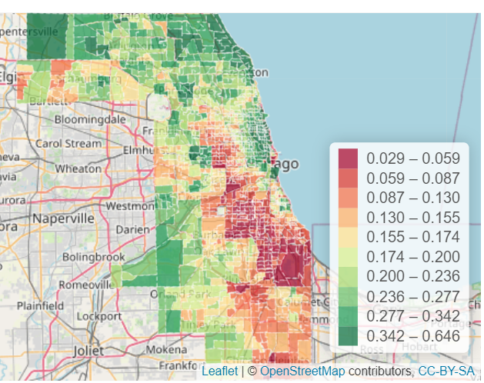
Appeal Rate (per residential property 2010 to 2020)

Slide 28
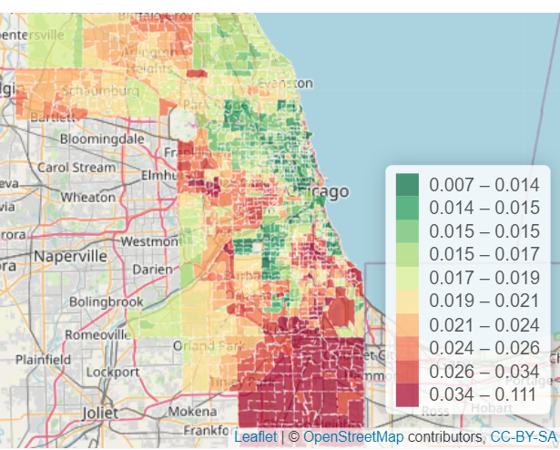
Effective Tax Rate

Slide 29
Jurisdiction Tax Rate Comparison
Jurisdiction | Homewood | Chicago
Schools | 10.686 | 3.807
Library | 0.593 | 0.14
Parks | 0.786 | 0.329
Other | 0.017 | 0.378
Cook County | 0.511 | 0.511
Municipality | 1.946 | 1.746
Total | 14.539 | 6.911

Slide 30
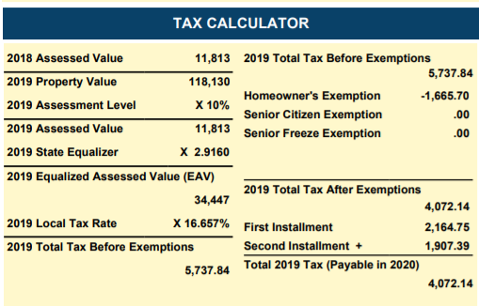
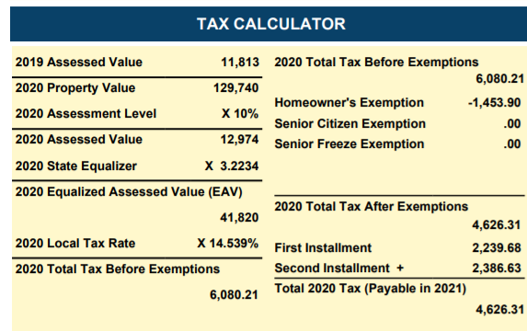
One issue with tax bills
$211.80 decrease in exemption, homeowner’s exemption is worth $100 * tax rate

Slide 31
Legislative/Administrative Solutions
Jurisdictional complexity of the three offices (Assessor, Board of Review, Treasurer)
Lack of coordination on appeals
Gap between assessment and tax bill
3-year reassessment cycle/Data Quality
Commercial/Residential Divide
Overly complicated exemptions process (administrative burden, overly complicated to apply for)

Slide 32
Free Software Package
The University of Chicago Center for Municipal Finance offers a free software package to analyze vertical equity in assessments
Written in R (free, open source statistical software)
Available at www.propertytaxproject.uchicago.edu

